Slide 1
AWS(Amazon Web Services)
P.Nishitha
20A31A0584

Slide 2
Contents:
Amazon EC2
Amazon vpc
Amazon EBS
Amazon AMI
Amazon ELB
Amazon Cloud watch
Amazon IAM

Slide 3
Amazon EC2
Task 1: Launch Your Amazon EC2 Instance
In the AWS Management Console choose Services, choose Compute and then choose EC2.choose launch instance.
Give the instance the name Web Server.
In the list of available Quick Start AMIs, select Amazon Linux AMI .
In the Instance type panel, keep the default t2.micro selected.
For Key pair name, choose vockey or create your own key pair.
In the network settings select vpc as Lab-vpc.
Under Firewall create a security with security group name and give description.
For Termination protection, select Enable.
Launch the EC2 instance.

Slide 4
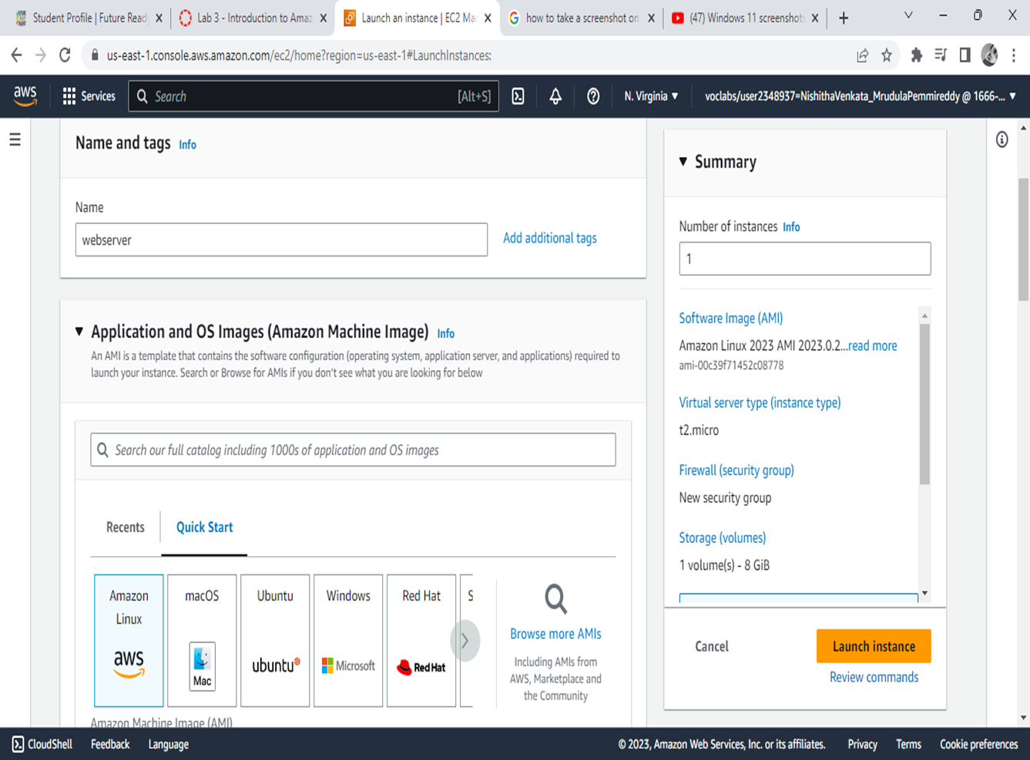

Slide 5
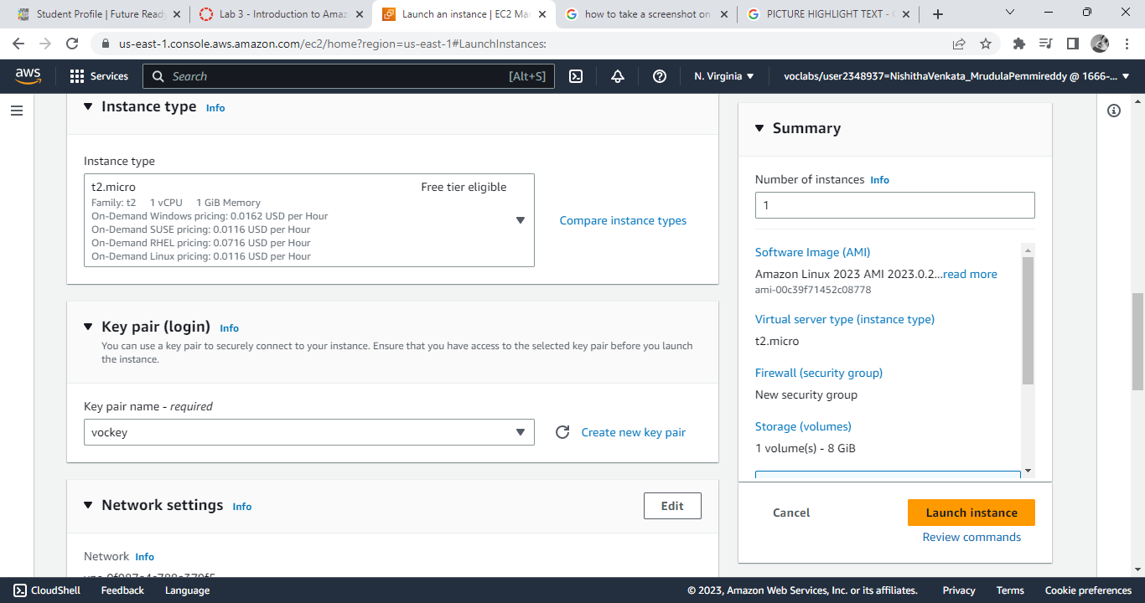


Slide 6
Task 2: Update Your Security Group
On the EC2 Console tab,in the left navigation pane, choose Security Group
Select Web Server security group
Choose Edit inbound rules, select Add rule and then configure:
Type: HTTP
Source: Anywhere-IPv4
Choose Save rules

Slide 7
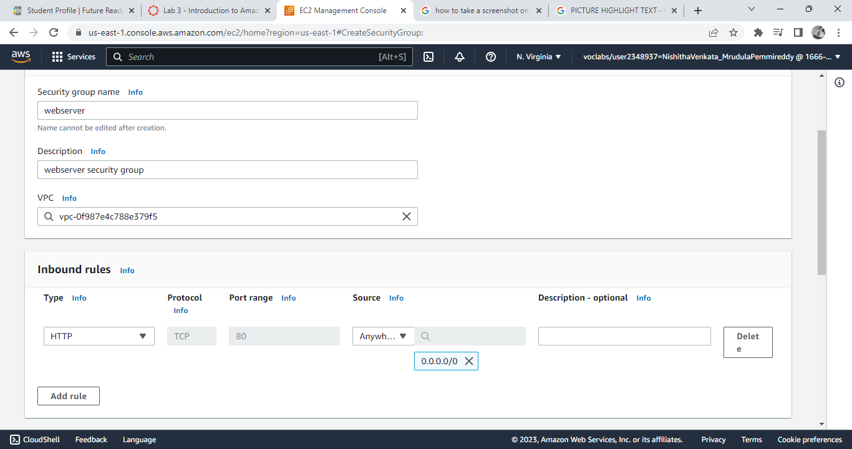

Slide 8
Amazon vpc
Task 1: Create Your VPC
In the search box to the right of Services, search for and choose VPC to open the VPC console.
Next, choose Create VPC
Under Name tag name it as Lab.
Keep the IPv4 CIDR block set to 10.0.0.0/16
For Number of Availability Zones, choose 1.
For Number of public subnets, keep the 1 setting.
For Number of private subnets, keep the 1 setting.
change Public subnet CIDR block in us-east-1a to 10.0.0.0/23
Change Private subnet CIDR block in us-east-1a to 10.0.1.0/24
Set NAT gateways to In 1 AZ.
set VPC endpoints to None.
Keep both DNS hostnames and DNS resolution enabled.
choose Create VPC

Slide 9
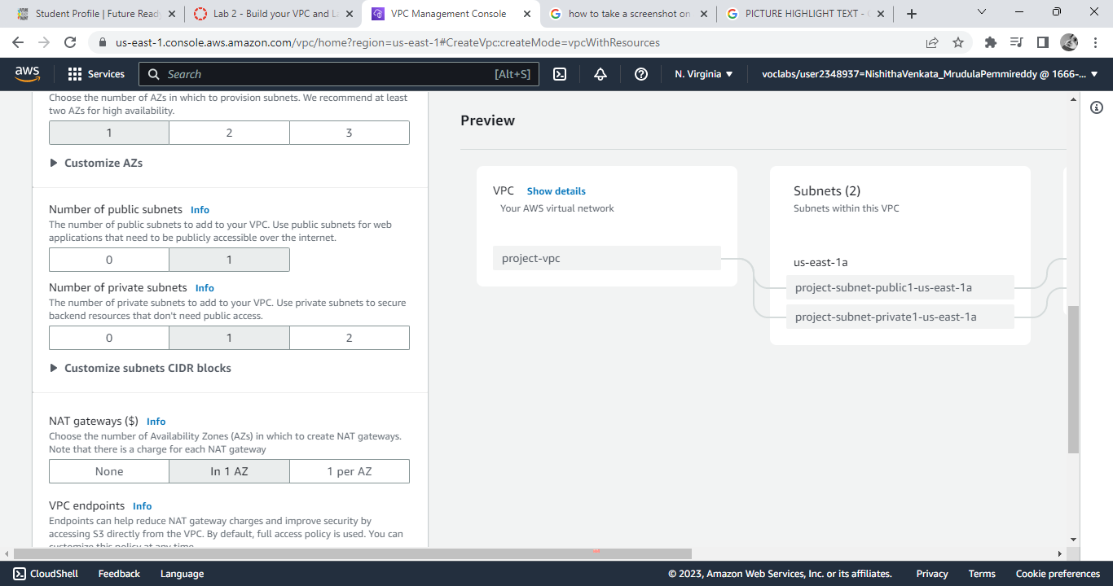

Slide 10
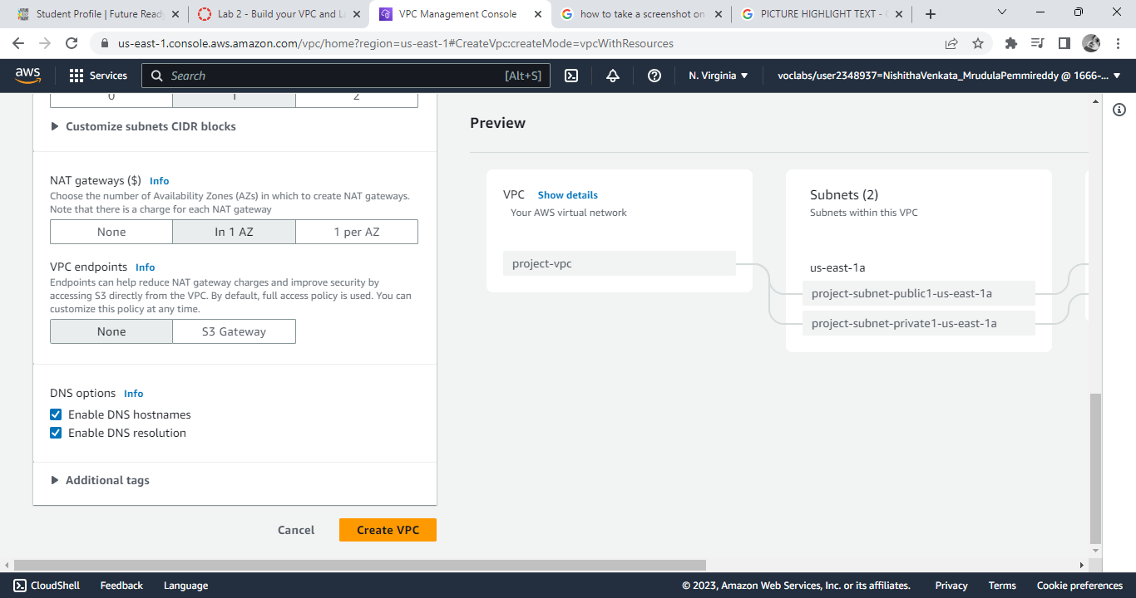

Slide 11
Task 2: Create Subnets and Route tables
In the left navigation pane, choose Subnets
Choose Create subnet then configure:
VPC ID: lab-vpc (select from the menu).
Subnet name: lab-subnet-public2
Availability Zone: Select the second Availability Zone (for example, us-east-1b)
IPv4 CIDR block: 10.0.2.0/24
Click create subnet
Create another subnet for lab-subnet-private2 with same configurations and 10.10.3.0/24 ipv4 address.
Now add route tables for the subnets, Select the lab-rtb-private1-us-east-1a route table.
Select edit association and select lab-subnet-private2.
Click save association
Do the same for lab-subnet-public2.

Slide 12
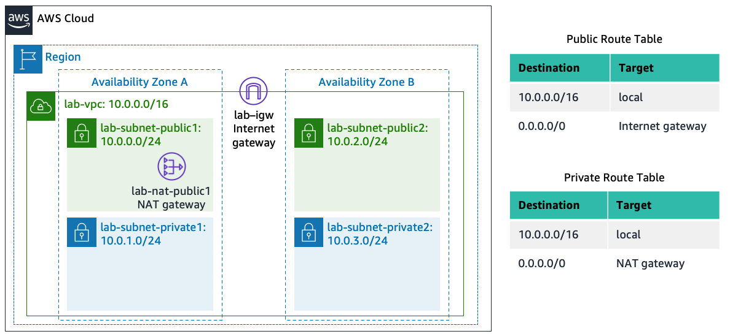

Slide 13
Amazon EBS
Task 1: Create a New EBS Volume
In the AWS Management Console, on the Services menu, click EC2.
Choose Create volume then configure:
Volume Type: General Purpose SSD (gp2)
Size (GiB): 1
Availability Zone: Select the same availability zone as your EC2 instance.
Choose Add Tag
In the Tag Editor, enter:
Key: Name
Value: My Volume
Choose Create Volume

Slide 14
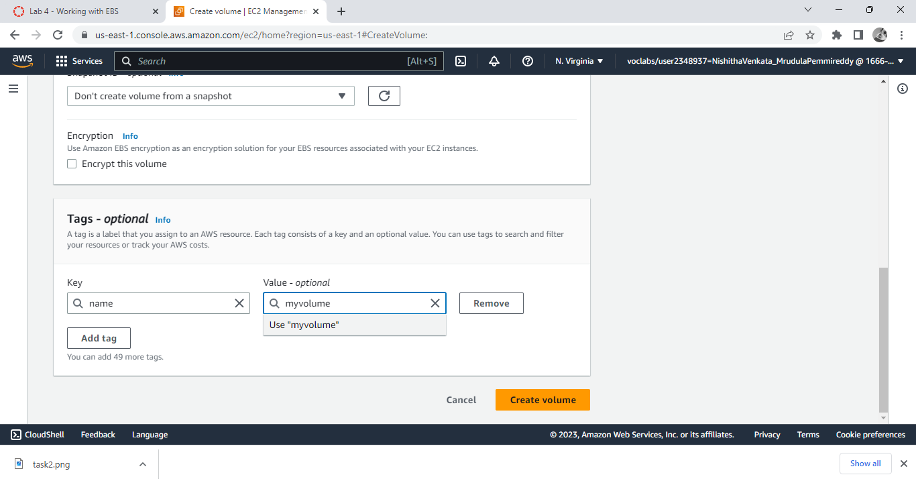

Slide 15
Task 2: Create an Amazon EBS Snapshot
In the AWS Management Console, choose Volumes and select My Volume.
In the Actions menu, select Create snapshot.
Choose Add tag then configure:
Key: Name
Value: My Snapshot
Choose Create snapshot

Slide 16
Amazon AMI
In the AWS Management Console, on the Services menu, click EC2.
In the left navigation pane, click Instances.
First, you will confirm that the instance is running.
Wait until the Status Checks for Web Server 1 displays 2/2 checks passed. Click refresh to update.
You will now create an AMI based upon this instance.
Select Web Server 1.
In the Actions menu, click Image and templates > Create image, then configure:
Image name: WebServerAMI
Image description: Lab AMI for Web Server
Click Create image

Slide 17
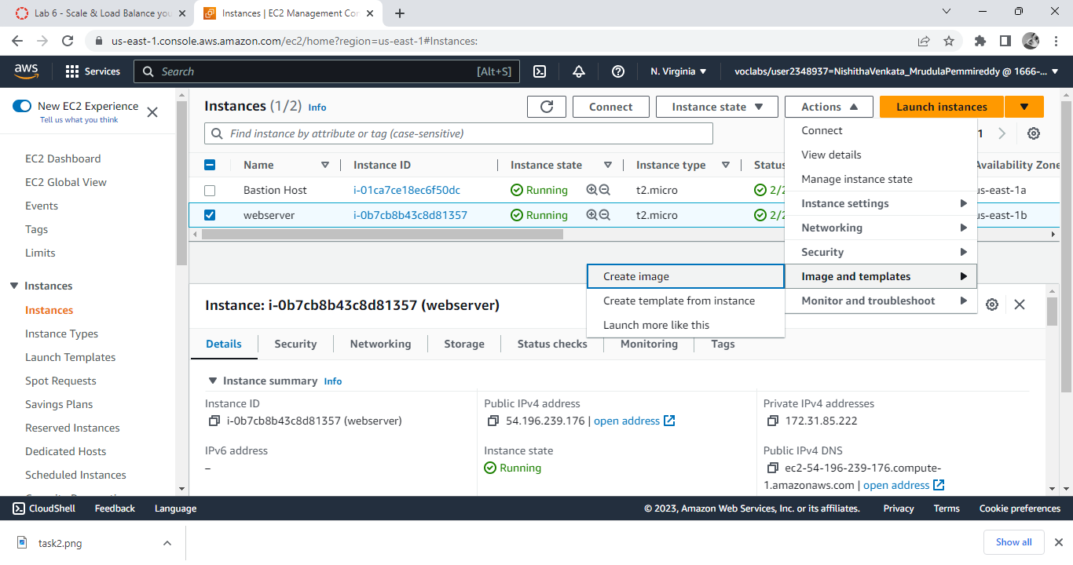

Slide 18
Elastic Load Balancer
In the left navigation pane, click Load Balancers.
At the top of the screen, choose
Under Application Load Balancer, choose Create
Under Load balancer name, enter: LabELB
Scroll down to the Network mapping section, then:
For VPC, select: Lab VPC
select Public Subnet 1 in 1st az
select Public Subnet 2 in 2nd az
choose the Security groups drop down menu and select Web Security Group
For the Listener HTTP:80 row, set the Default action to forward to LabGroup.
Scroll to the bottom and choose Create load balancer

Slide 19
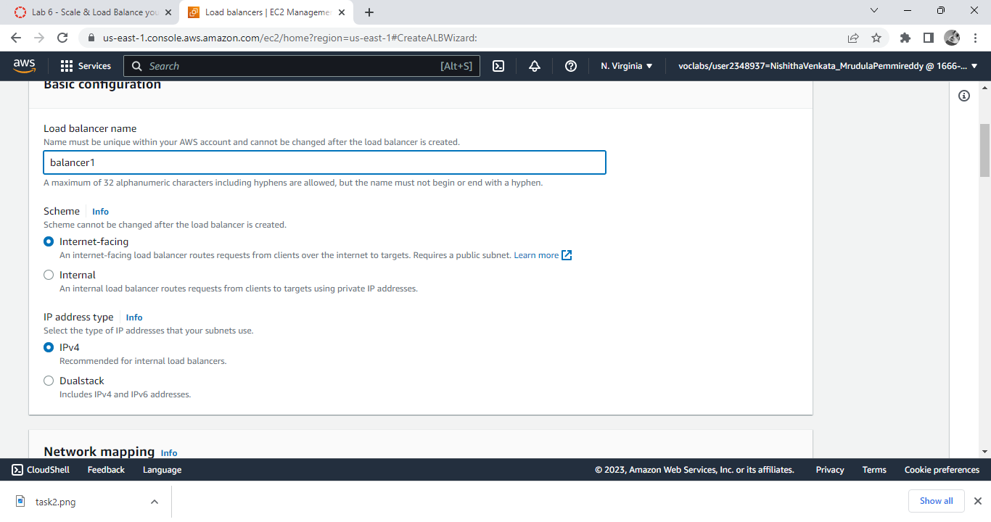

Slide 20
Cloud watch
On Aws management console choose cloud watch and the click billing.
Choose create alarm
Change currency to rupees.
Define the threshold value to1000.
Click Next.
Choose create new topic.
Give name and email address and click create topic
Click next and click create.

Slide 21
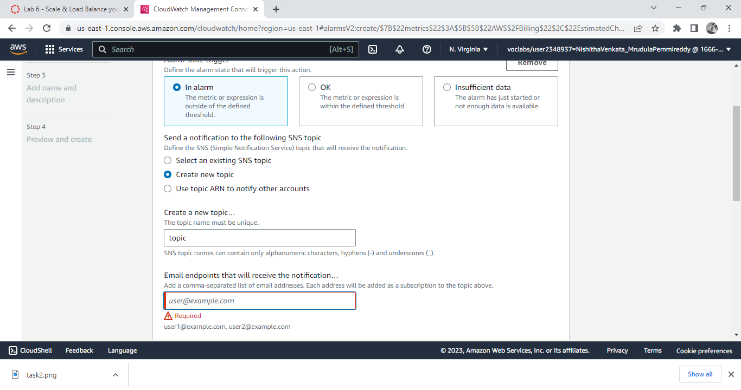

Slide 22
Amazon IAM
ON AWS management search for the iam and select it
Now see users and usergroups and add users to the usergroups.
In the left navigation pane, choose User groups.
Choose the S3-Support group.
Choose the Users tab.
In the Users tab, choose Add users.
In the Add Users to S3-Support window, configure the following:
Select user-1.
At the bottom of the screen, choose Add Users.
In the Users tab you will see that user-1 has been added to the group.

Slide 23
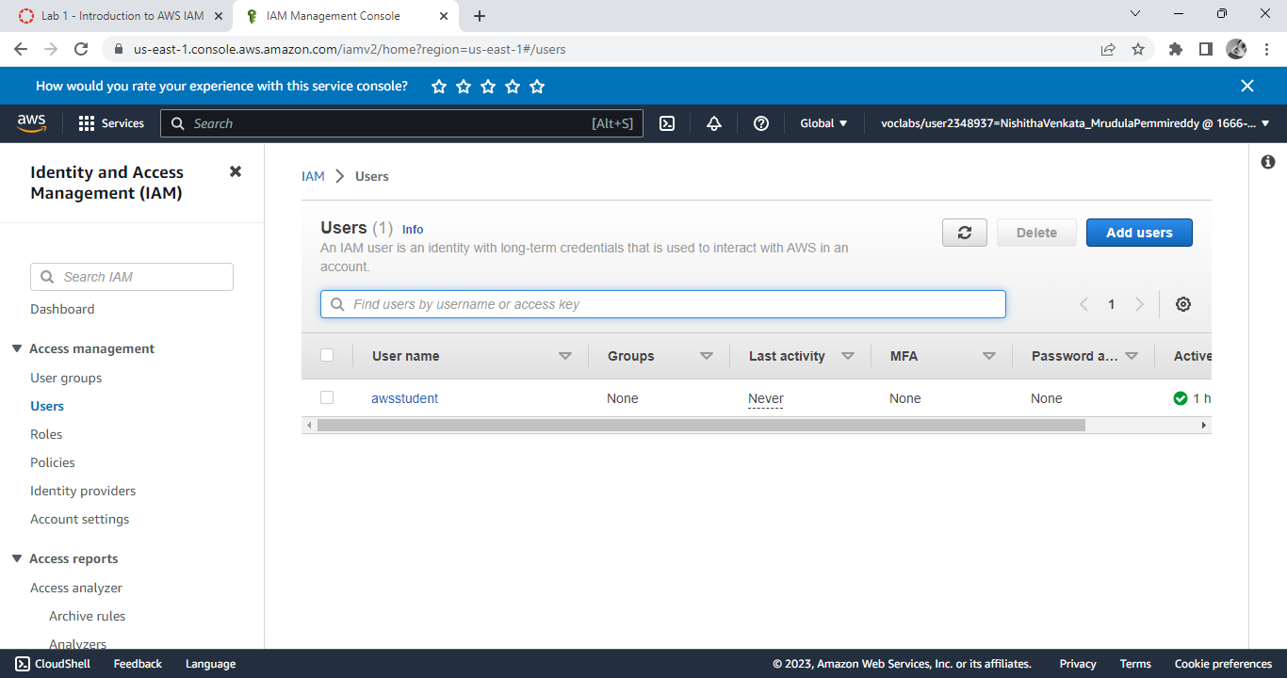

Slide 24
THANK YOU

